Slide 1
Azure Best Practices
Architecting Complex Solutions with Heavy Loads
By Damir Dobric
daenet Gesellschaft für Informationstechnologie

Slide 2
Agenda
1 – The true Cloud Pains
2 – Limits of hypes: my lovely Docker
3 – Cannot believe, I chose VMs
4 – Relativity Theory of load balancing
5 – Recap

Slide 3
The TRUE cloud PAINs

Slide 4
Limits of Hype: My lovely docker
💓

Slide 5
Relativity Theory of Load Balancing

Slide 6
Processing of requests in ASP.NET WebApi
Thread
Object
Thread
Object
Thread
Object
Thread
Object
Thread
Object
Thread
Object
HTTPS Requests
Thread
Object
Thread
Object
Thread
Object
Thread
Object
Thread
Object
Thread
Object
Thread
Object
Thread
Object
[HttpGet("ping/{arg}")]
public async Task<string> Ping(int arg)
{
var obj = new MyObject(null);
var res = await obj.Run(delay);
return res;
}

Slide 7
You are limited by available RAM
Object
Thread
Object
HTTPS Requests
Thread
Object
Thread

Slide 8
Object Pool Pattern
ASP.NET WebApi
Thread 1
Object
Thread 2
HTTPS Requests
Object
Thread 3
Object
Thread 4

Slide 9
Object Pool Pattern
ASP.NET WebApi
Thread 1
Object
Thread 2
HTTPS Requests
Object
Thread 3
Object
Thread 4

Slide 10
Object Pool Pattern
ASP.NET WebApi
Thread 1
Object
Thread 2
Object
HTTPS Requests
Thread 3
Object
Thread 4

Slide 11
Object Pool Pattern
ASP.NET WebApi
Thread 1
Object
Thread 2
Object
HTTPS Requests
Thread 3
Object
Thread 4

Slide 12

Object Pool Pattern
ASP.NET WebApi
Thread 1
Object
Thread 2
Object
HTTPS Requests
Thread 3
Object
Thread 4

Slide 13
Object Pool Pattern with “WAIT QUEUE”
ASP.NET WebApi
Thread 1
Object
Thread 2
Object
HTTPS Requests
Thread 3
Object
Thread 4

Slide 14
Object Pool Pattern with “WAIT QUEUE”
ASP.NET WebApi
Thread 5
Thread 2
Object
HTTPS Requests
Thread 3
Object
Thread 4
Object

Slide 15
Object Pool Pattern
ASP.NET WebApi
Thread 1
Object
Thread 2
HTTPS Requests
Object
Thread 3
Object
Thread 4

Slide 17
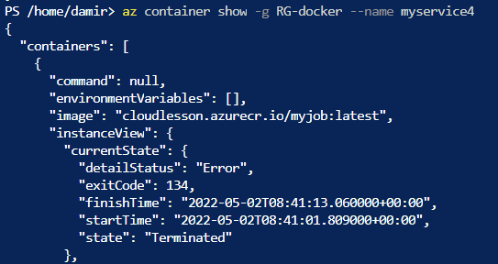
Killing my Docker softly
Inspect the container
Exit Code 134
Abnormal termination (SIGABRT)
Container Abnormally Terminated itself
Status Out of Memory
Exit Code 137
Immediate Termination (SIGKILL)
Docker Kill
Status OOMKilled

Slide 18
Unsere Kompetenzen​
Cloud Lösungen​
Internet of Things​
KI
Maßgeschneiderte Cloud-Lösungen​ für Microsoft Azure.​
Modernisierung von Anwendungen.​
Integration von Systemen.​​
Digitalisierung von Prozessen.​
Modernisierung und Implementierung von IIOT Lösungen.
Digitalisierung von Industrie-Prozessen.
Implementierung von selbstlernenden Lösungen.
Integration von KI/ML in die Softwarelösungen.

Slide 19
Summary
1 – Key Lernings 1
2 – Key Lernings 2
3 – Key Lernings 3
4 – Key Lernings 4
5 – Key Lernings 5

Slide 20
Questions & Answers

Slide 21






Visit us....
Get your feedback:
https://daenet.de/de/contact/
https://daenet.de/de/
https://www.meetup.com/azure-meetup-frankfurt/
https://developers.de/
https://www.linkedin.com/company/daenet
https://fb.watch/7p-_oFJhxl/
https://www.instagram.com/daenetcommunity/
https://twitter.com/daenetv
Copyright @daenet 2021

Slide 22
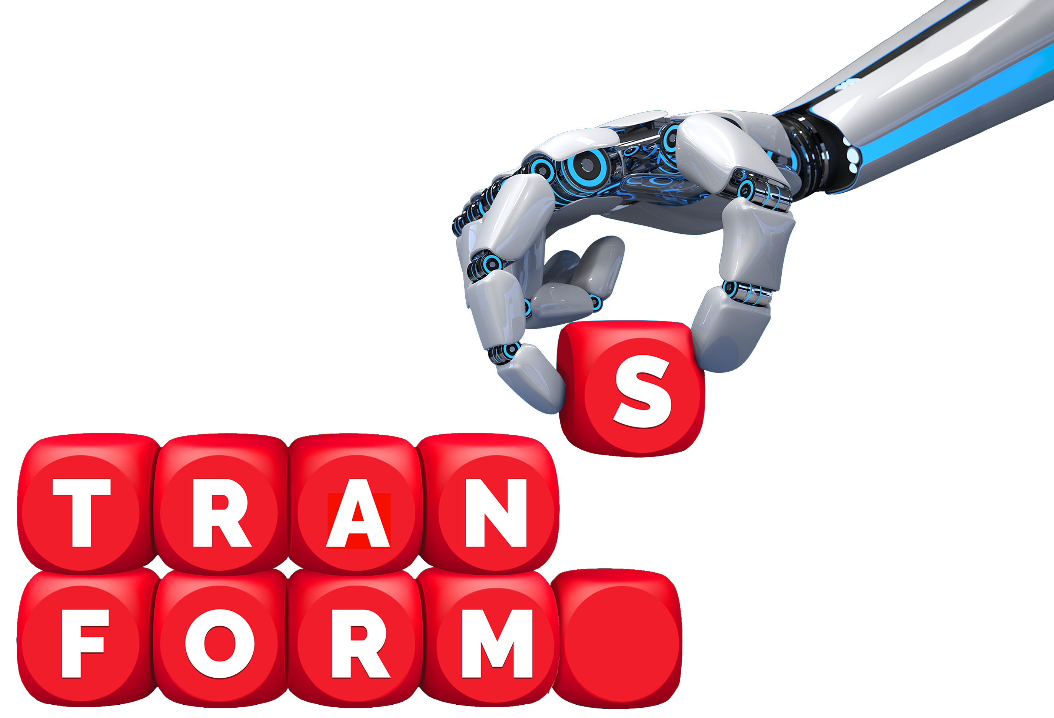
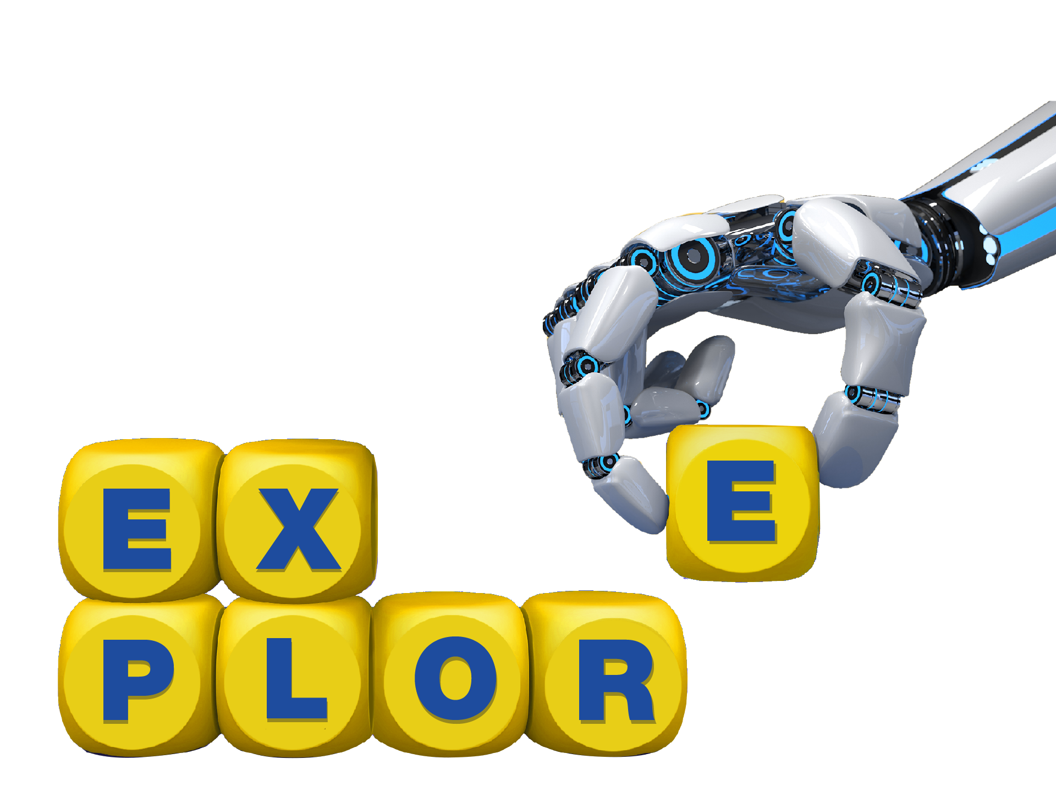
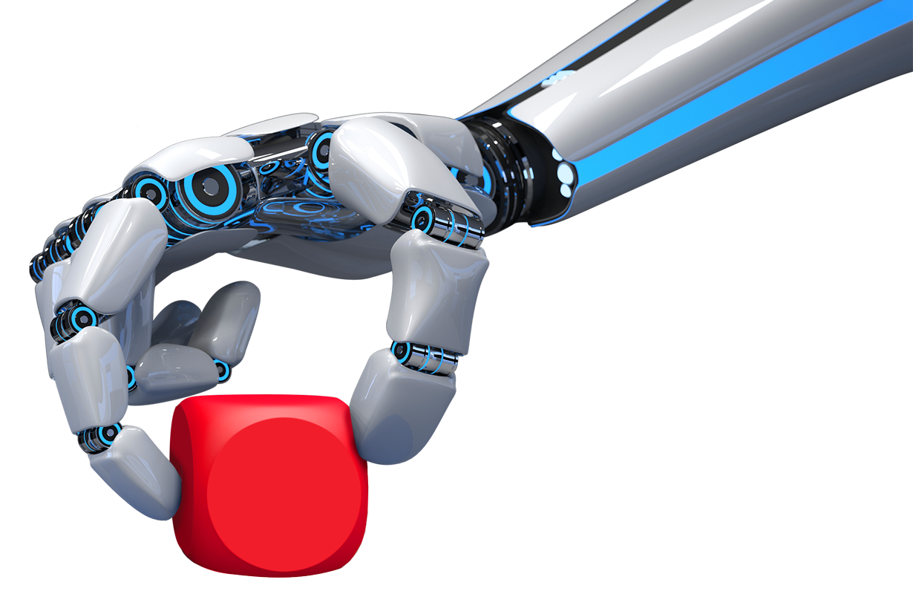

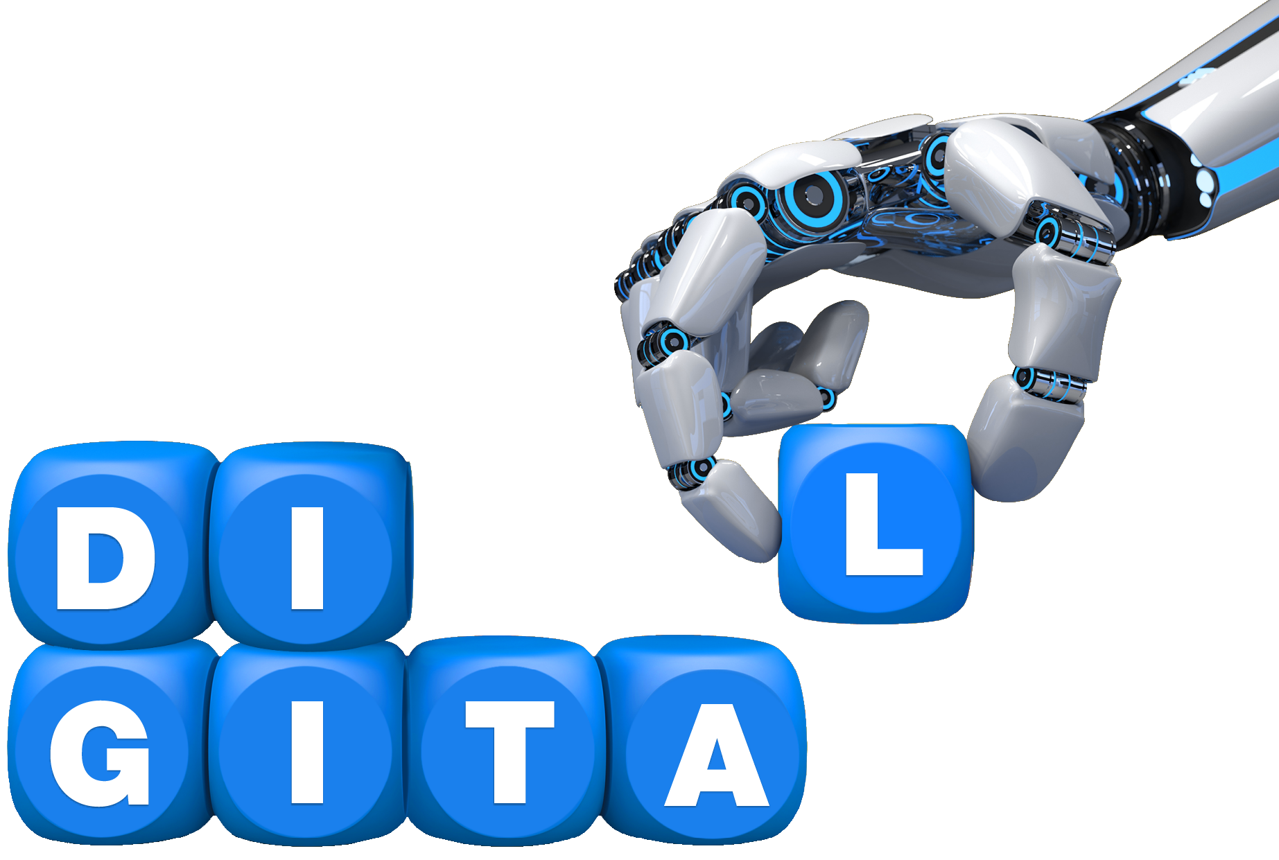






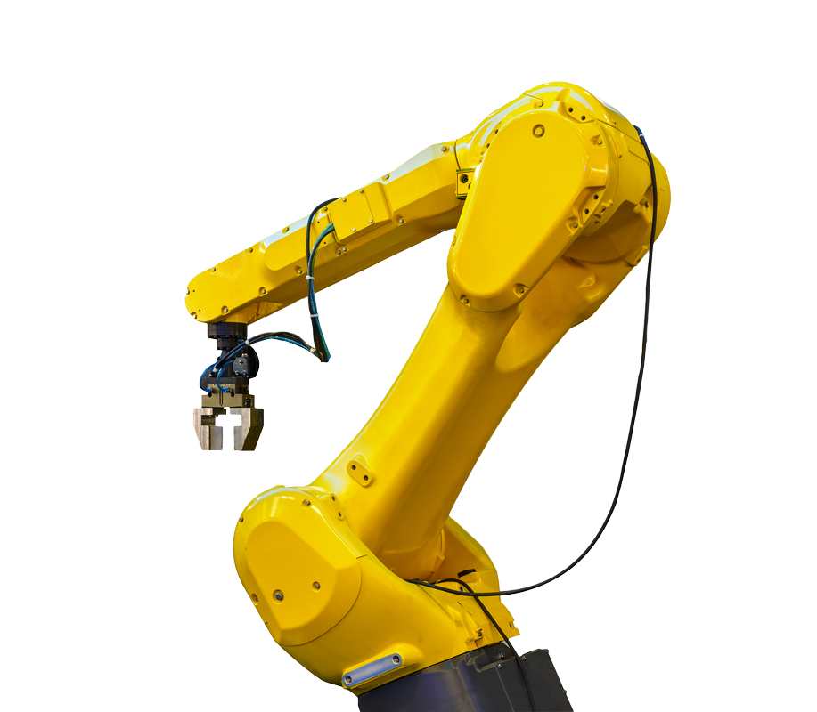

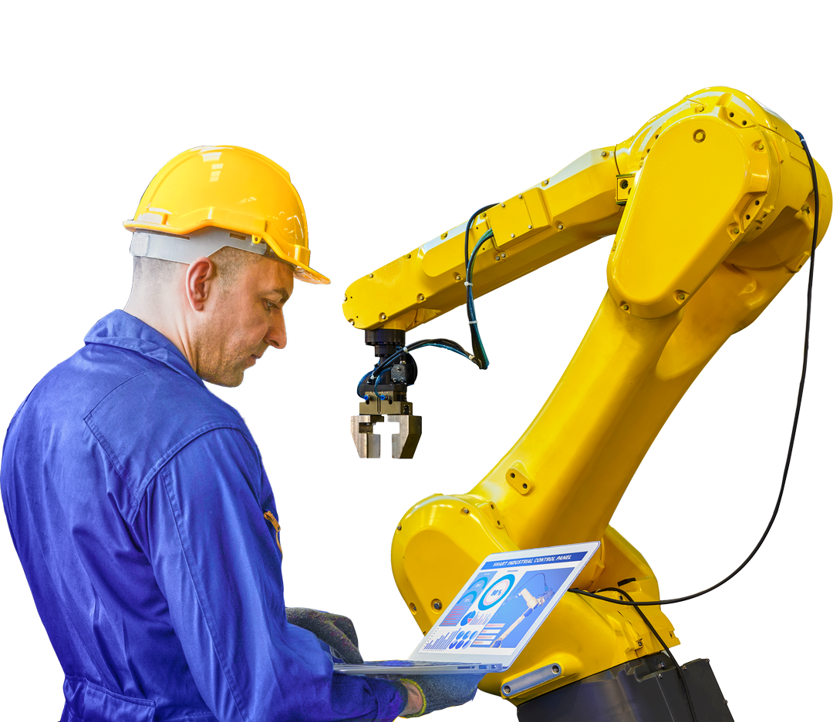


Pictures, images and icons
Cloud
IoT
ML/AI

Slide 23

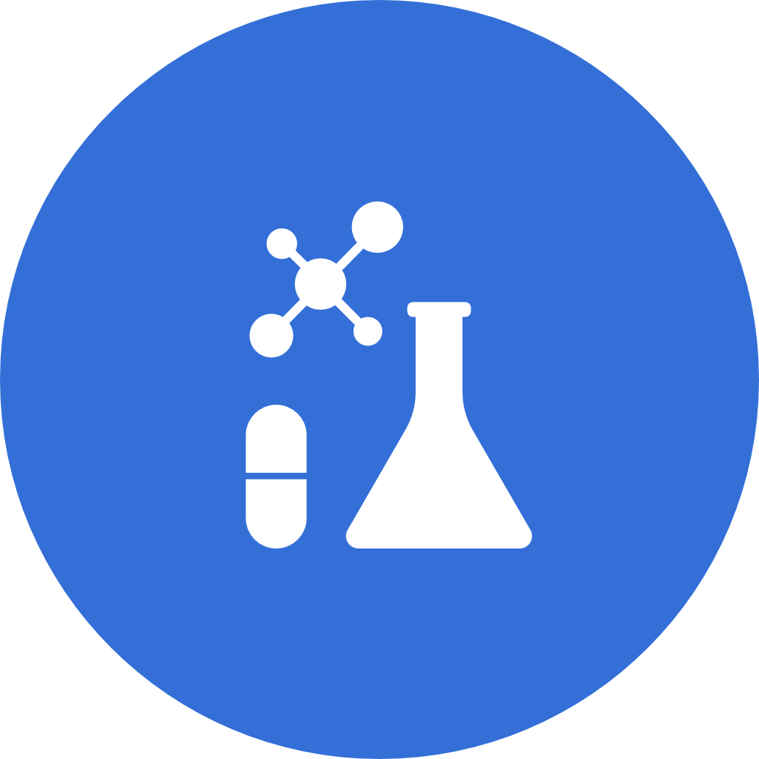
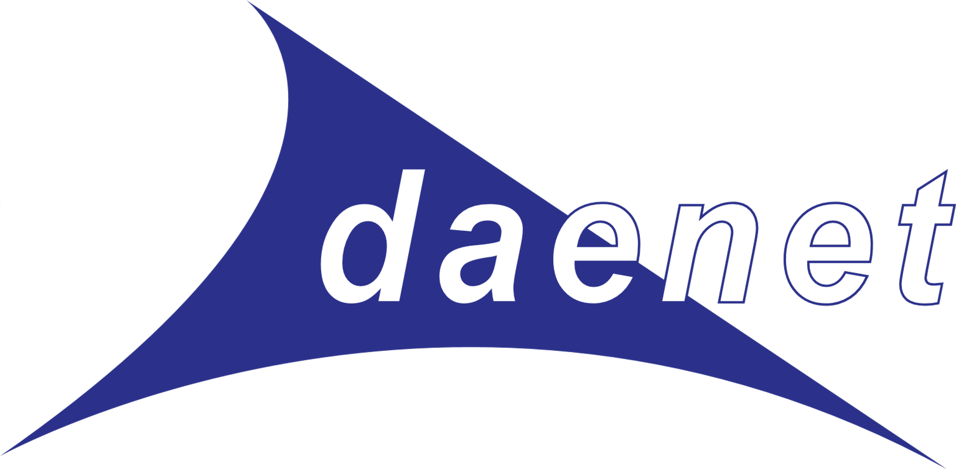



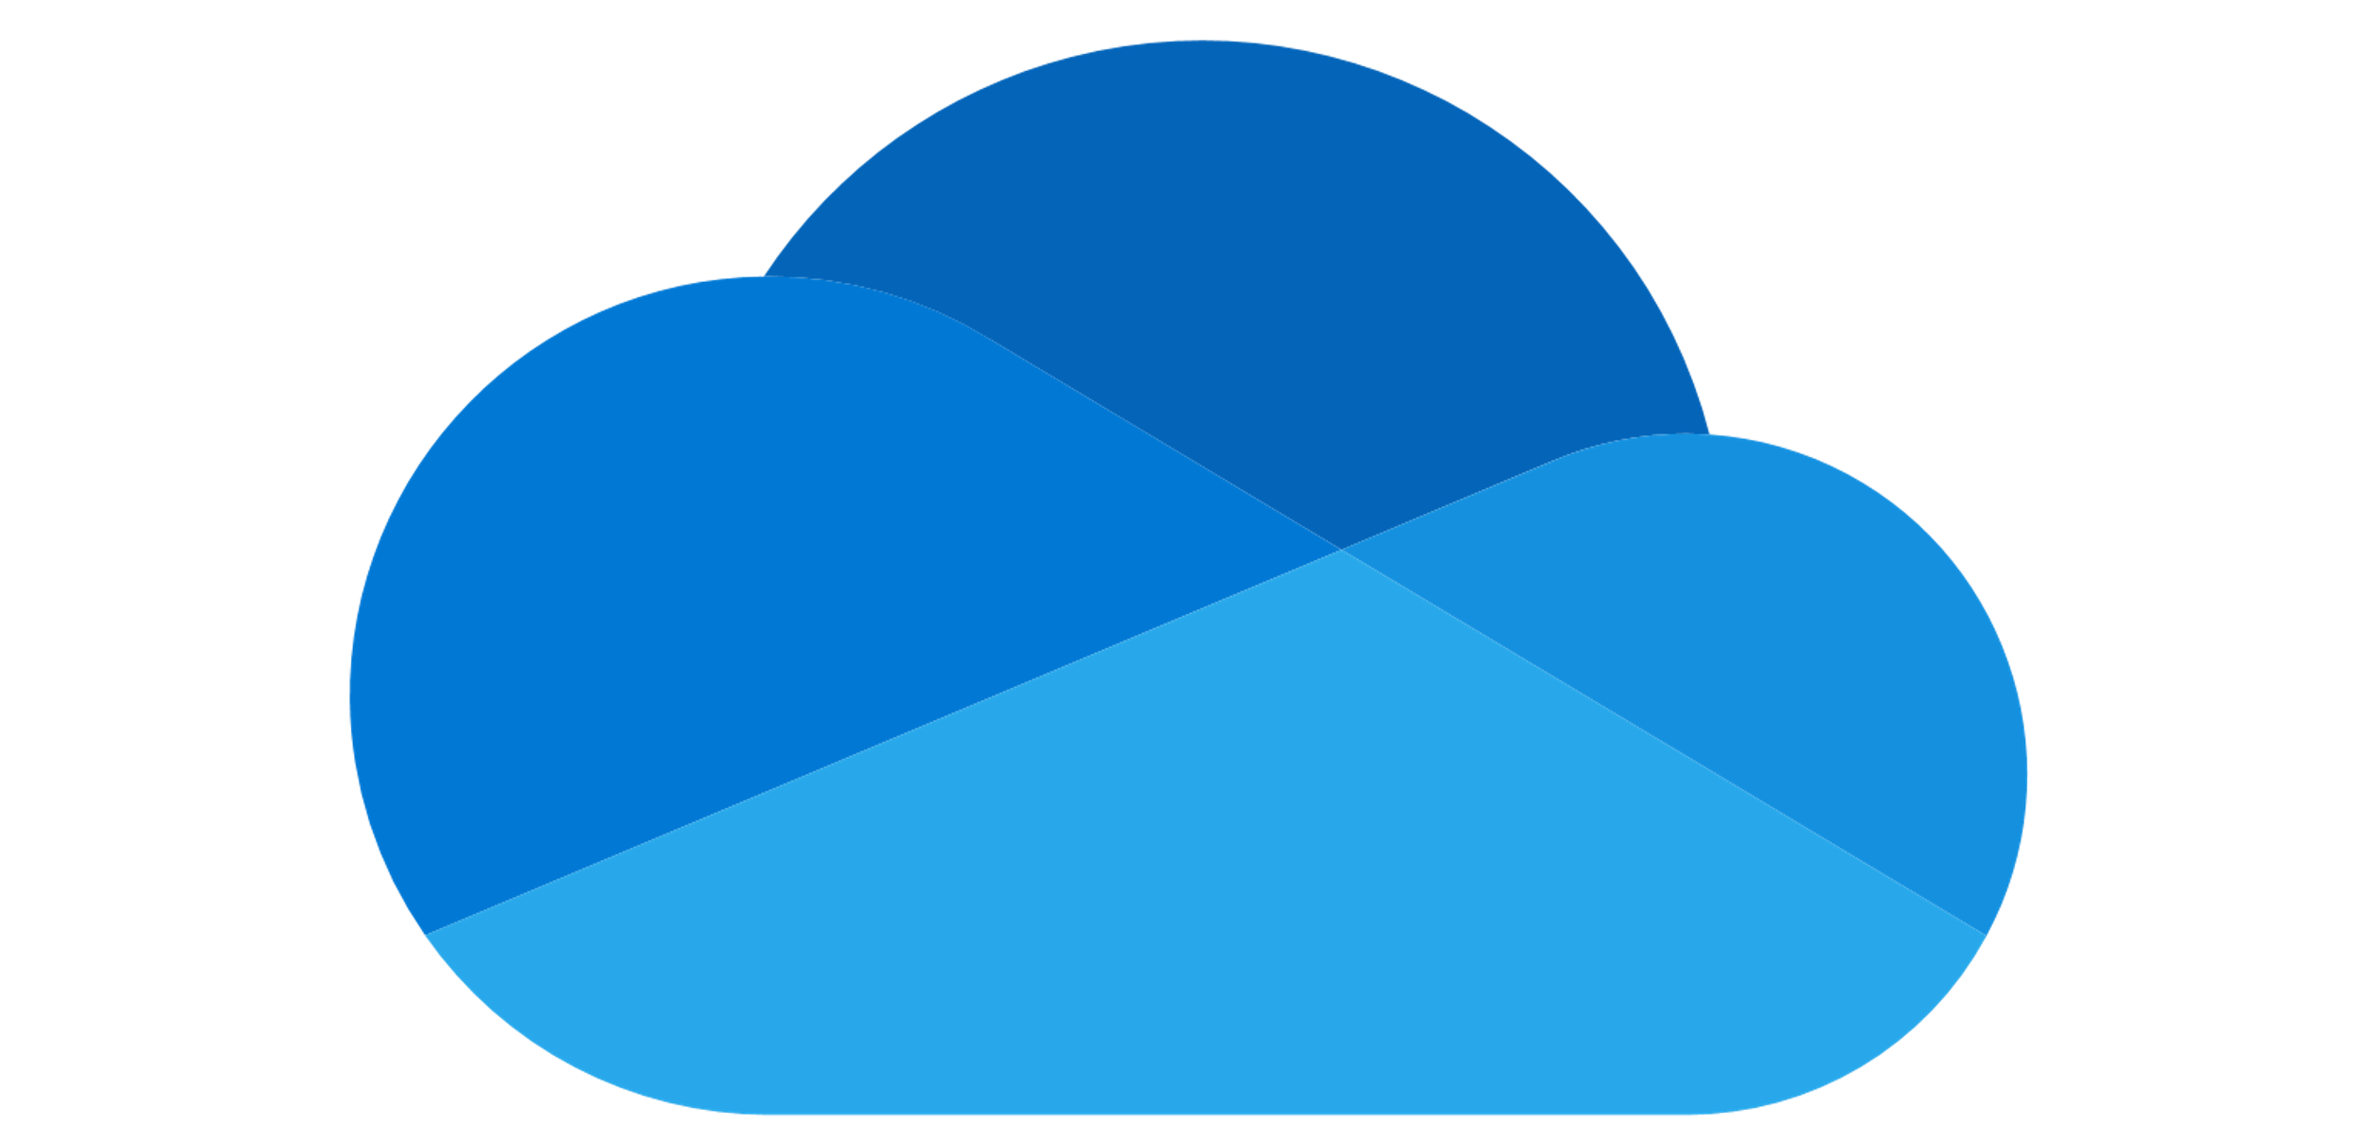










Pictures, images and icons

Slide 24

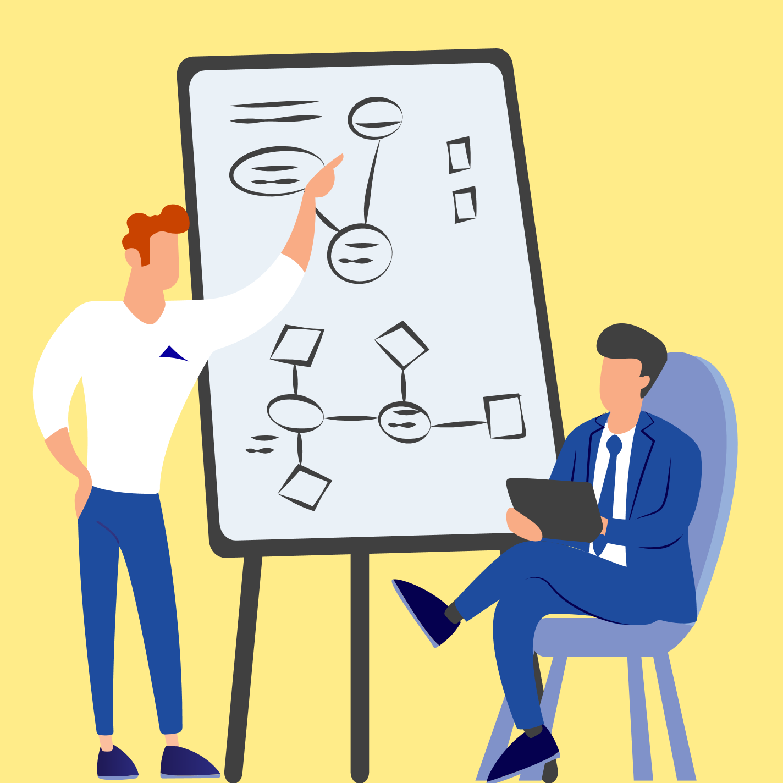
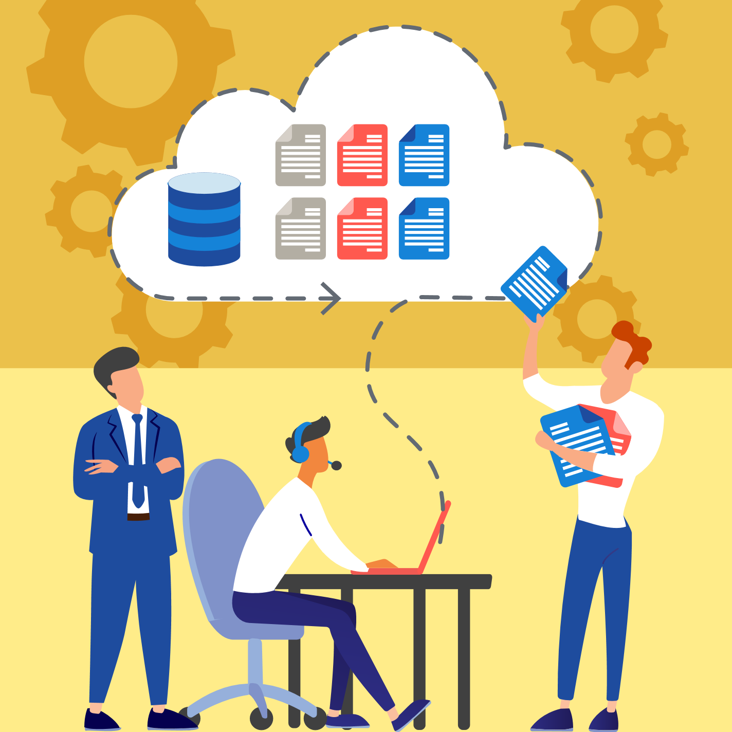

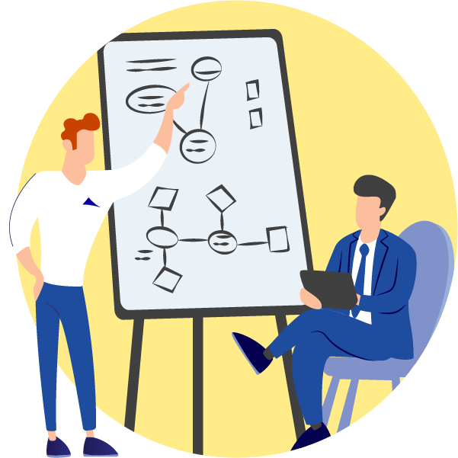

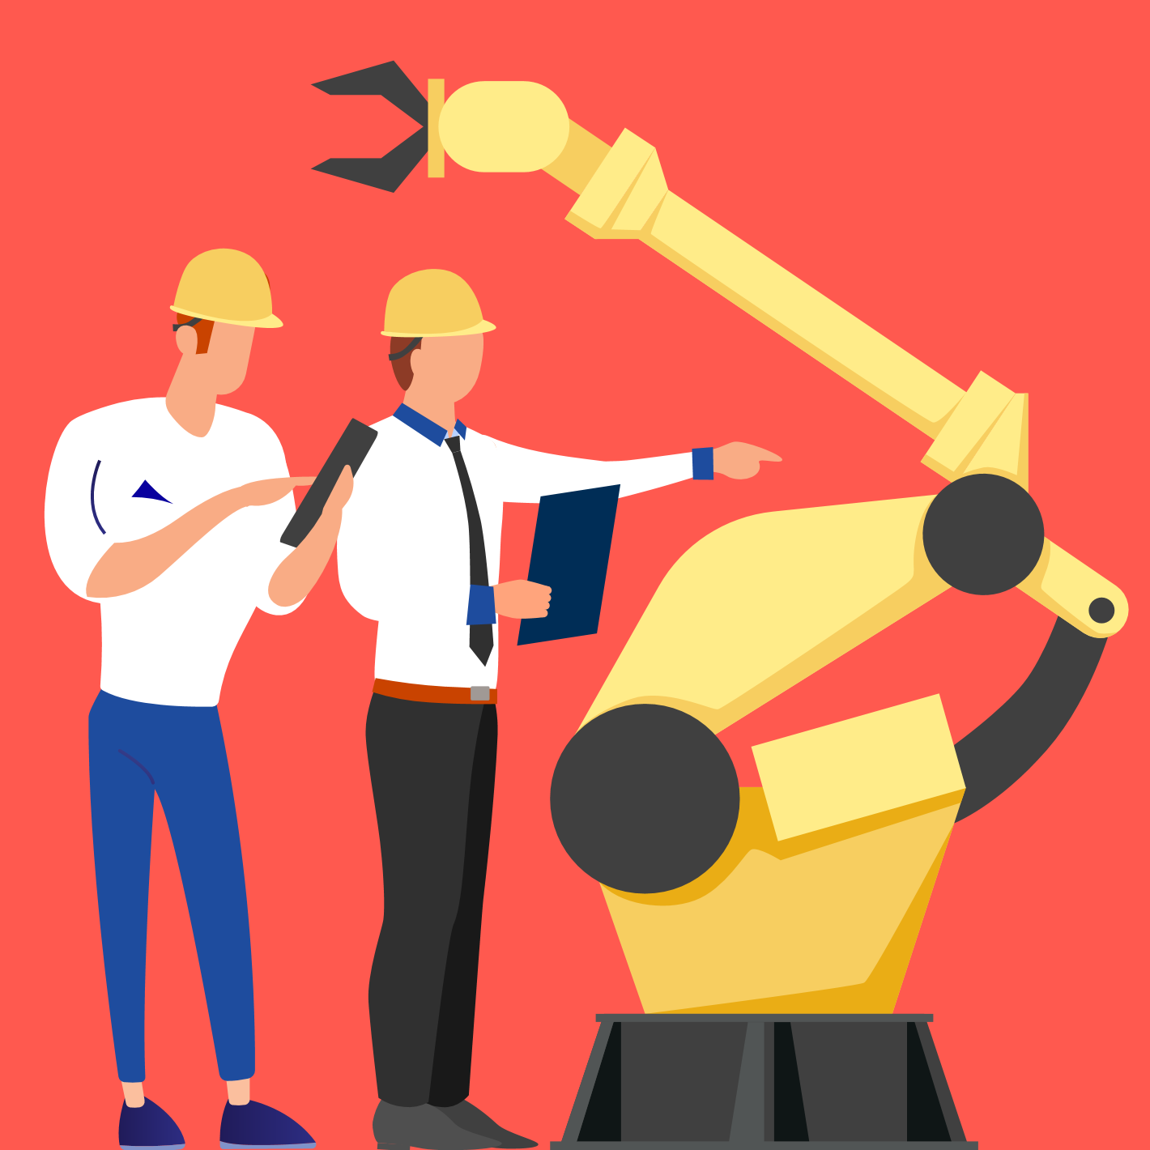
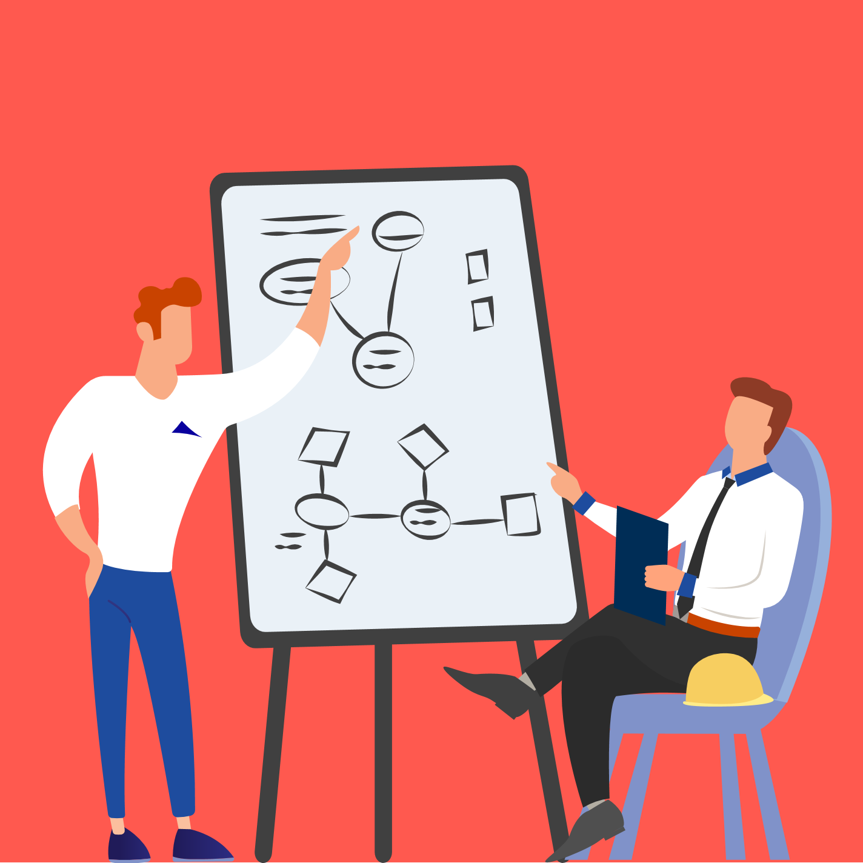


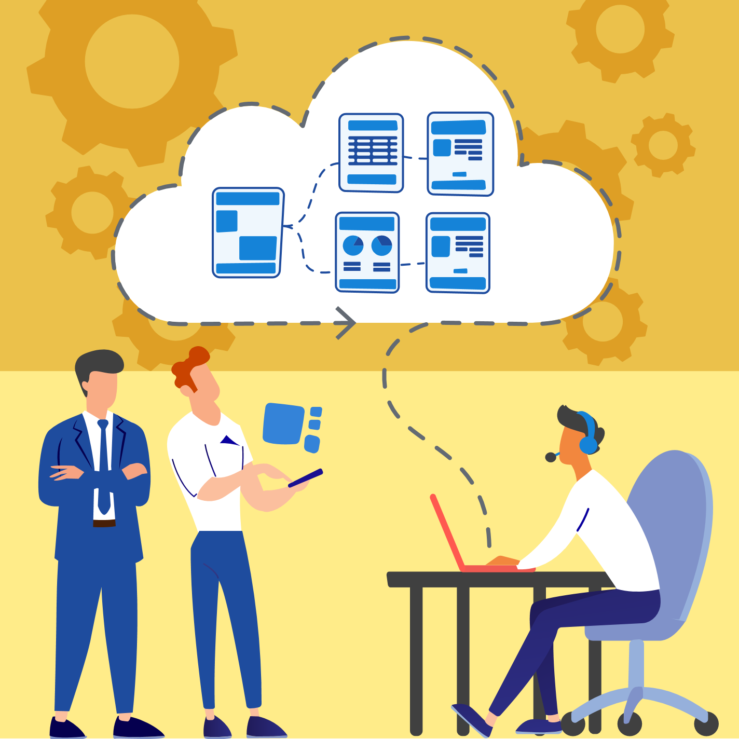
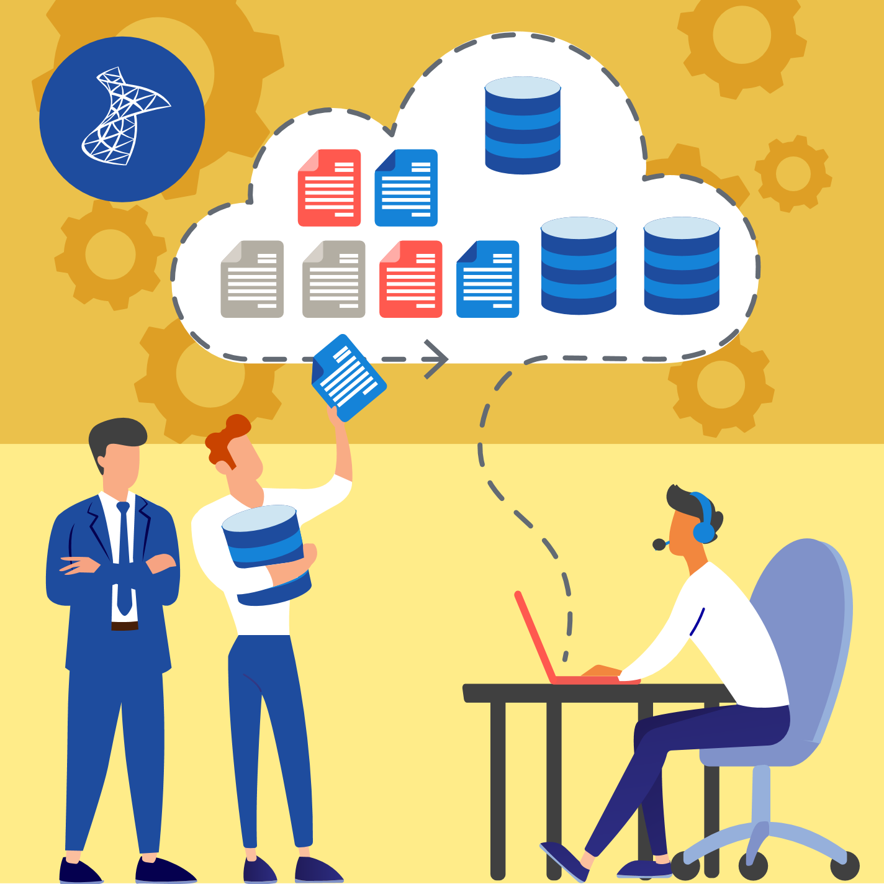

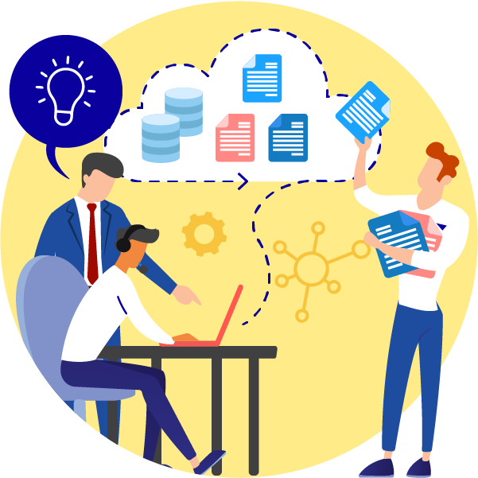

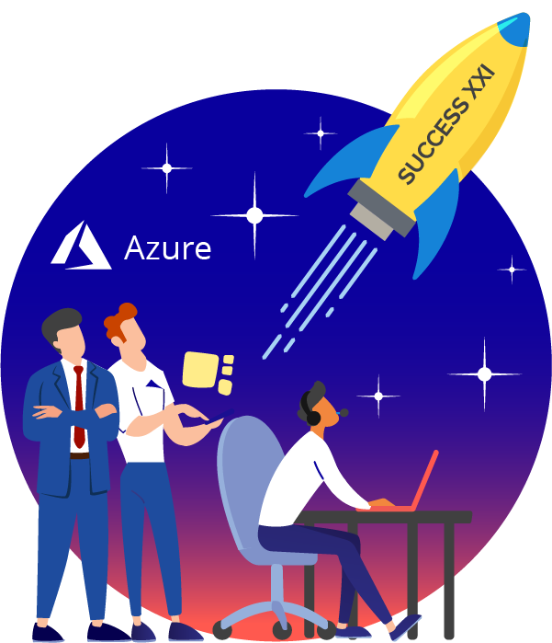

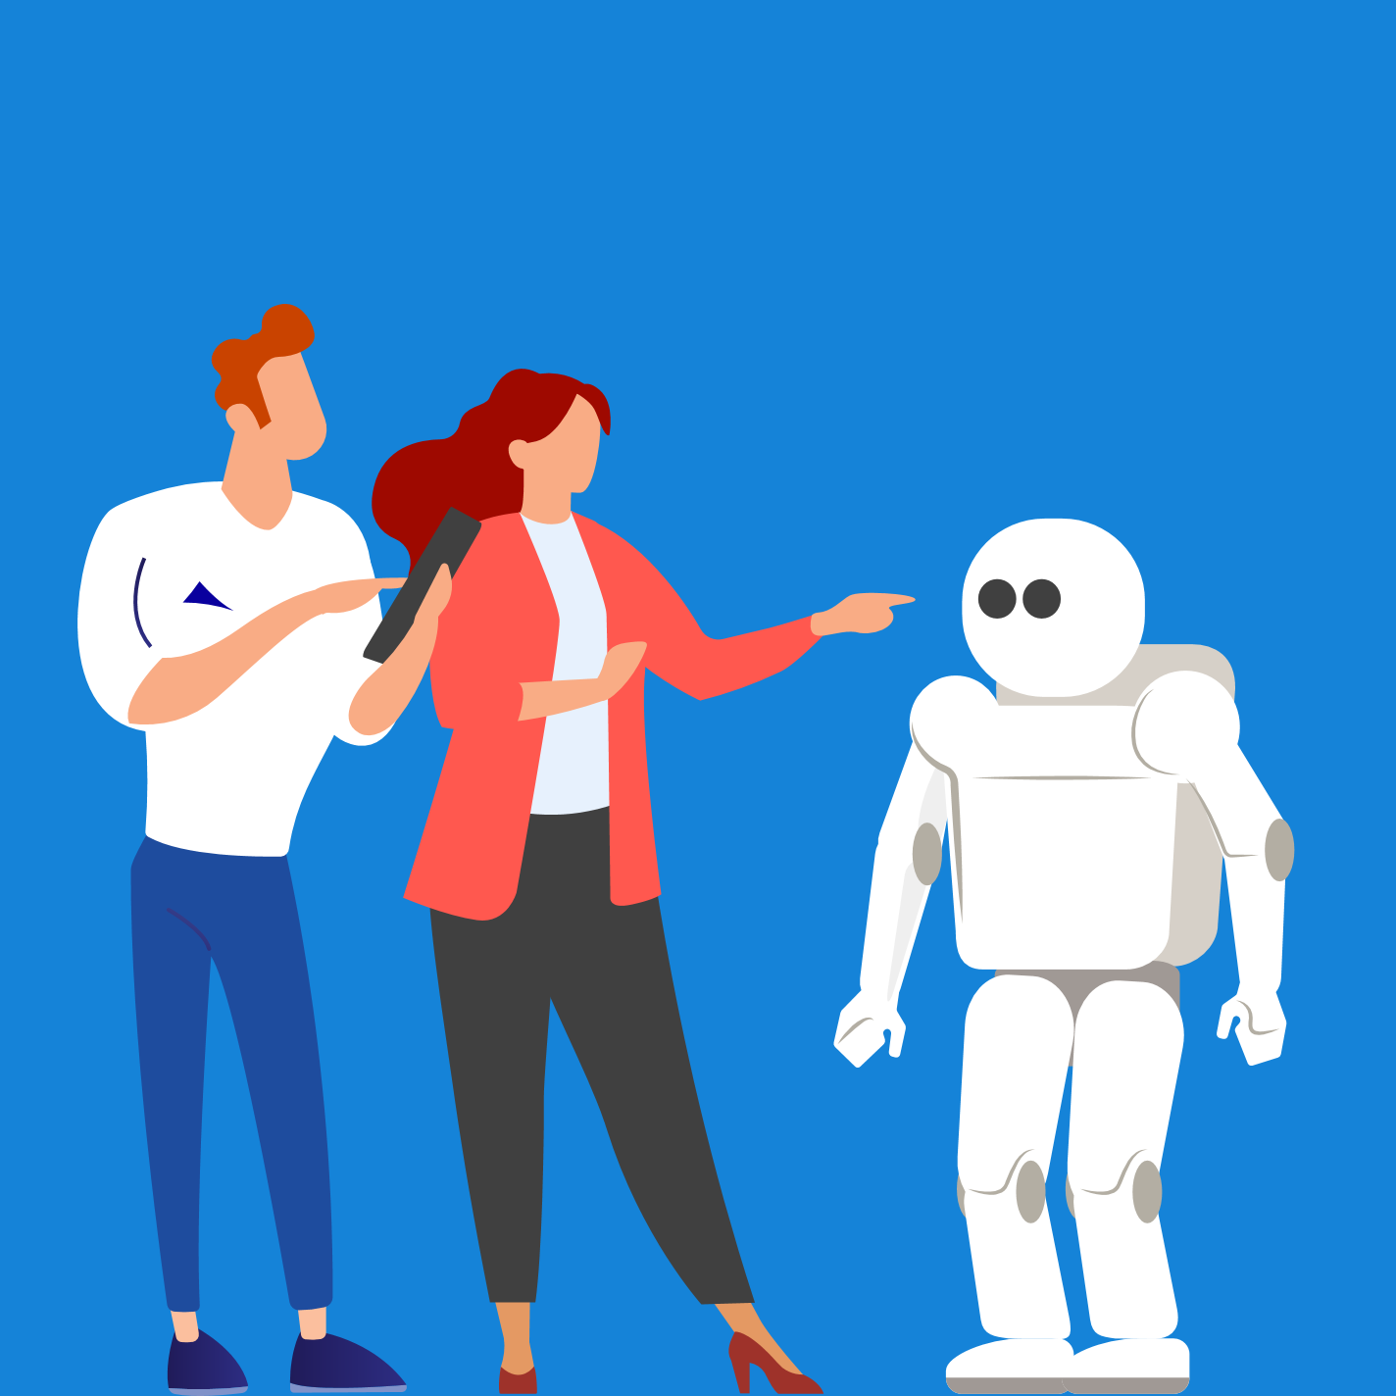
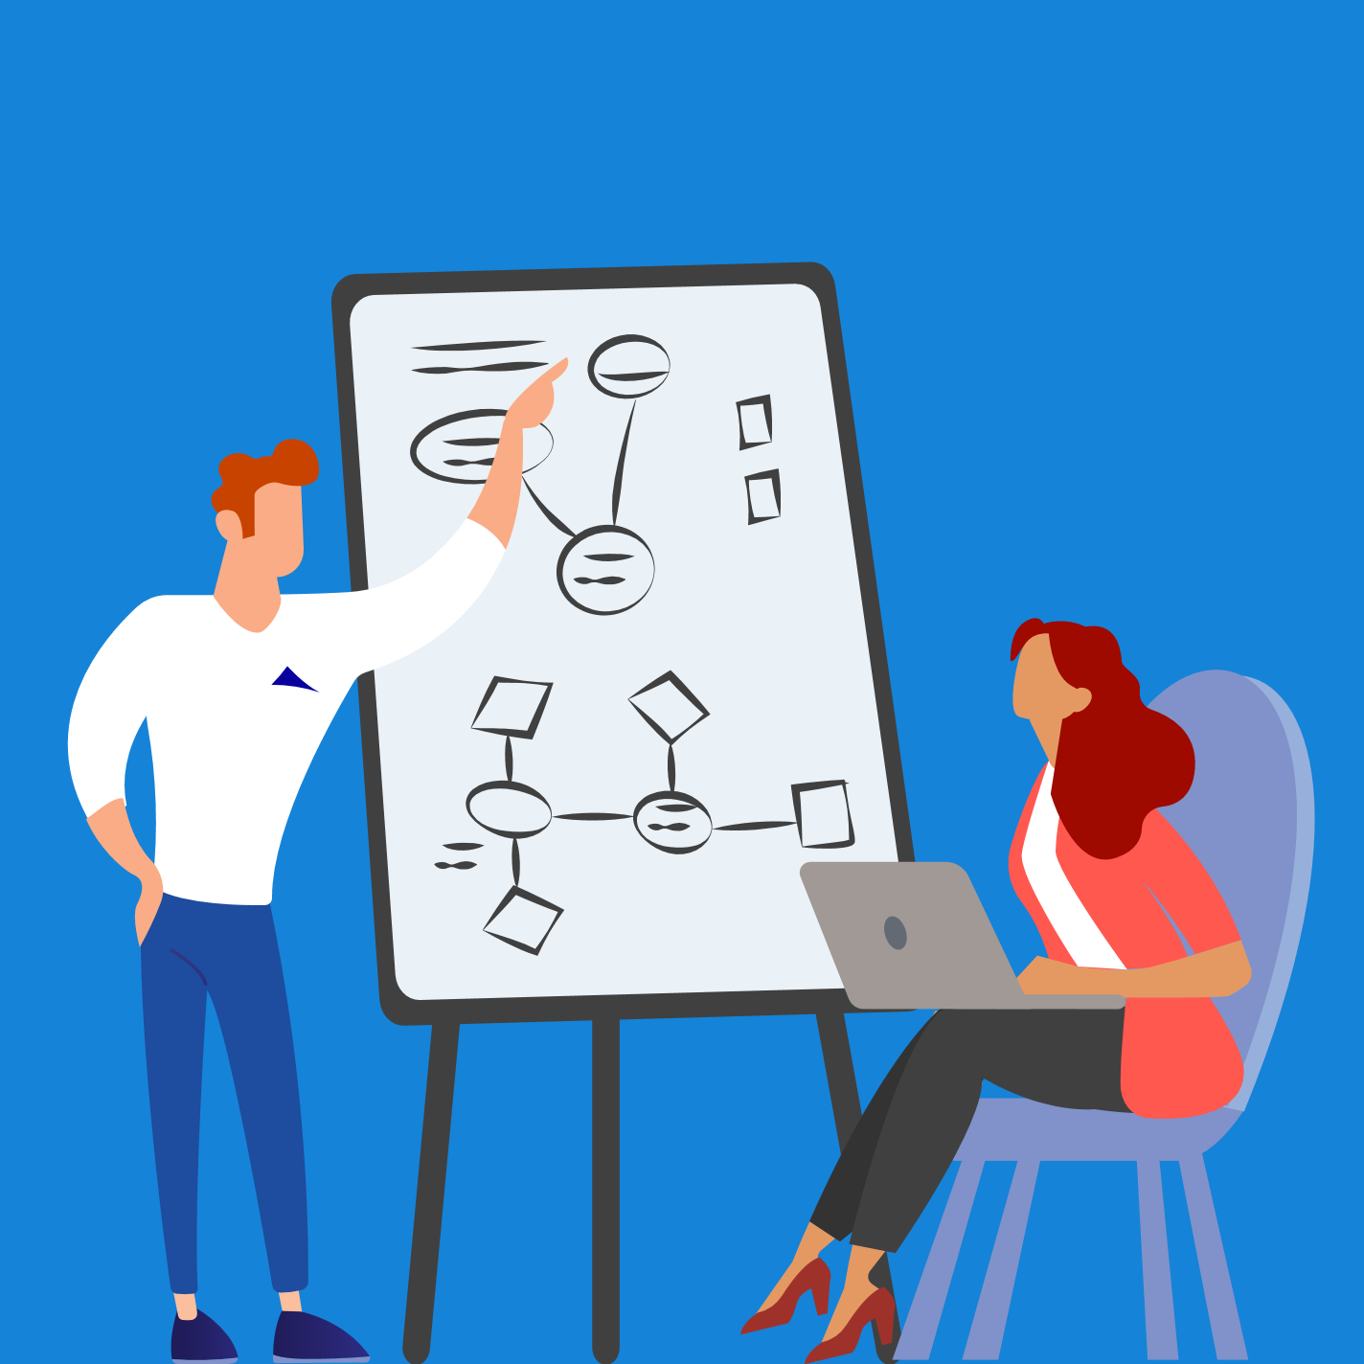


Pictures, images and icons
Cloud
IoT
AI/ML

